Slide 1

Automated marketing research using online user reviews

Slide 2

Contents :
1 . Introduction
Approach
Dataset description
Methodology
Evaluation
References

Slide 3
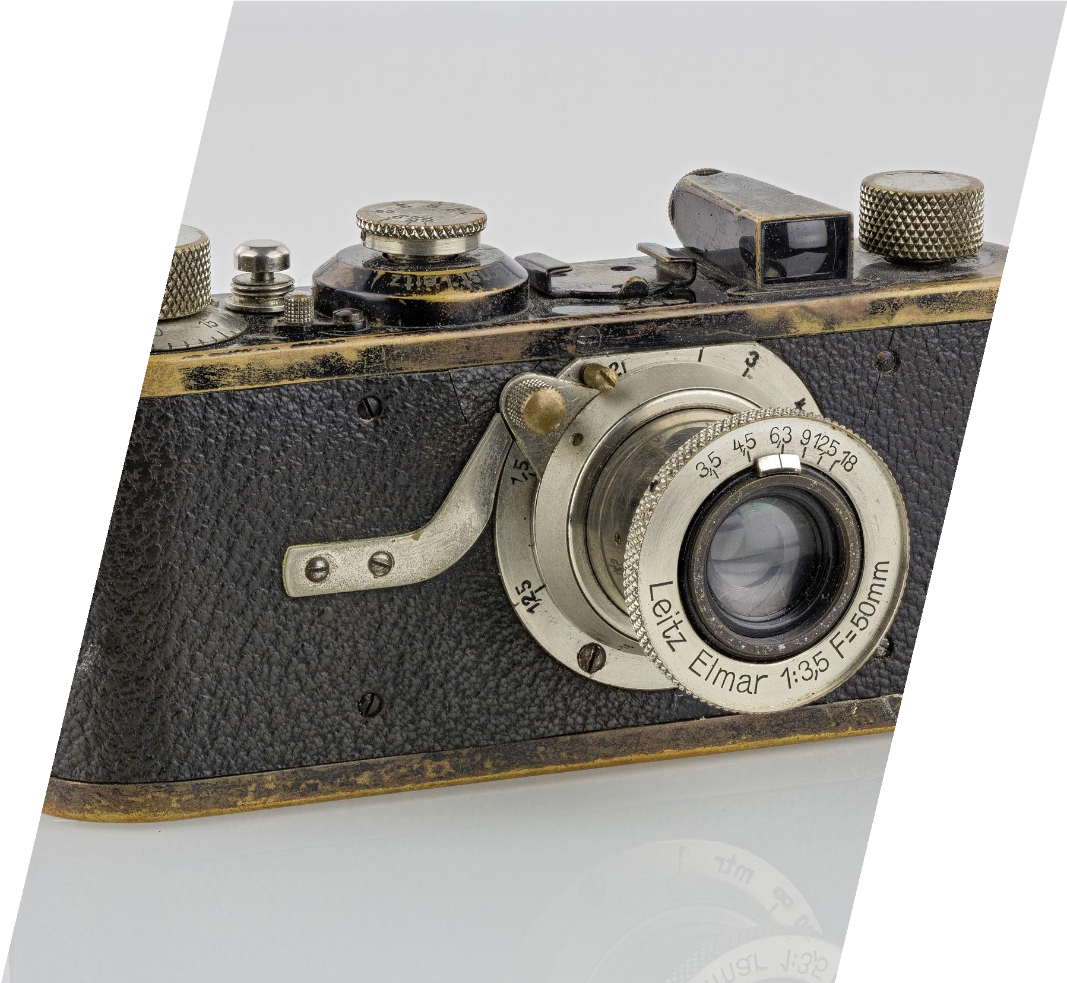

Problem statement :
Selecting product attributes for market structure analysis

Slide 4
Problem Description

Slide 5
Market Structure Analysis
Central to marketing
Key step in
Design and development of new products
Repositioning of existing products
Describes substitution and complementary relationship between brands
Predicts market responses to:
Changes in pricing
Market strategy
Product introduction

Slide 6
Uses Surveys
Uses the thought:
Traditional Approach to Market Structure Analysis
“All customers perceive all products the same way with difference in attribute evaluation only”
Little research on how to choose product attributes i.e. keywords
Voice of Customer not being used for choosing keywords for marketing

Slide 7
Our Approach
Our approach facilitates Market Structure Analysis in 2 ways:
Selecting attributes based on Voice of Customer
Selecting product attributes for marketing on the basis of what customers are concerned about
Augmenting Traditional approaches by providing input

Slide 8
Approach
Data Collection:
Web Page scraping to get user reviews
Clustering:
Term-Document Matrix
Clustering of terms based on cosine similarity
Using k-means
Correspondence Analysis

Slide 9
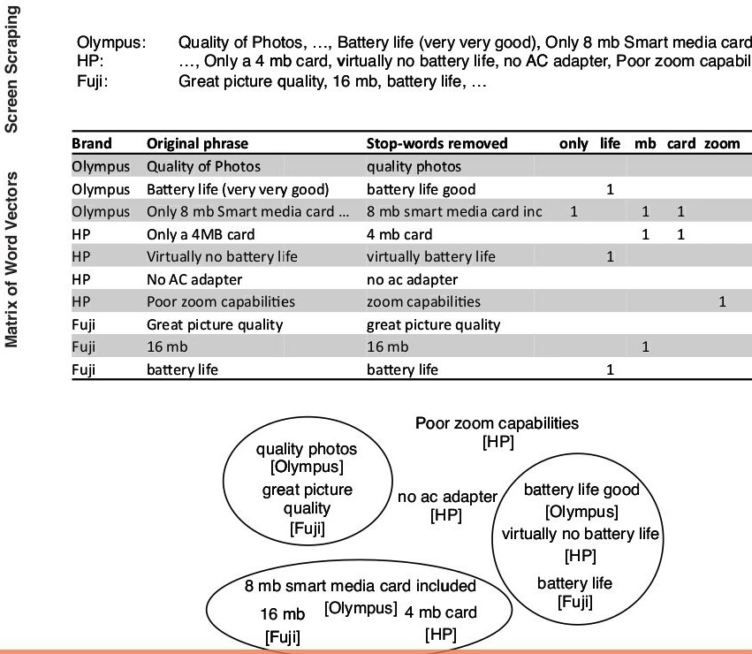
Methodology

Slide 10
Data Collection :
Collected the online user reviews for digital cameras

Slide 11

Scraping
Web scraping is a technique to automatically access and extract large amounts of information from a website, which can save a huge amount of time and effort.

Slide 12
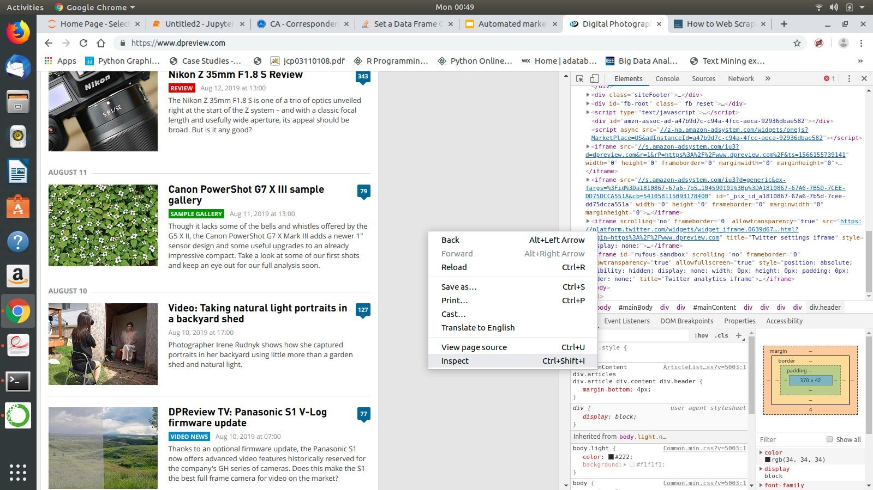
Scraping
Inspecting the Web page :

Slide 13
It is a python library for pulling out data from Html and xml ﬁles
Beautiful soup parses the document using the best available parser . (we have used html parser).
Beautiful soup :
Beautiful Soup transforms a complex HTML document into a complex tree of Python objects.

Slide 14
Identifying the useful links :
Fetch all tags <a href=’...’ >
Use regular expressions to extract links of products

Slide 15
Examples :
https://www.dpreview.com/samples/2514 555088/canon-rf-24-240mm-f4-6-3-is-sa mple-gallery
https://www.dpreview.com/articles/50227 81382/is-the-panasonic-lumix-dc-s1r-right
-for-you

Slide 16
Extract reviews :
Iterate over all the links we got .
Find all elements <div class = ‘message >
Iterate over all div tags and fetch <p>...<p>

Slide 17
Data Preprocessing
Convert in lowercase
Remove stopword
Remove punctuation
Remove url
Stemming

Slide 18
K-means Clustering
It is partition based algorithm. It is most popular algorithms for text mining.
It is efﬁcient on the large data.
It work on the numerical data.

Slide 19
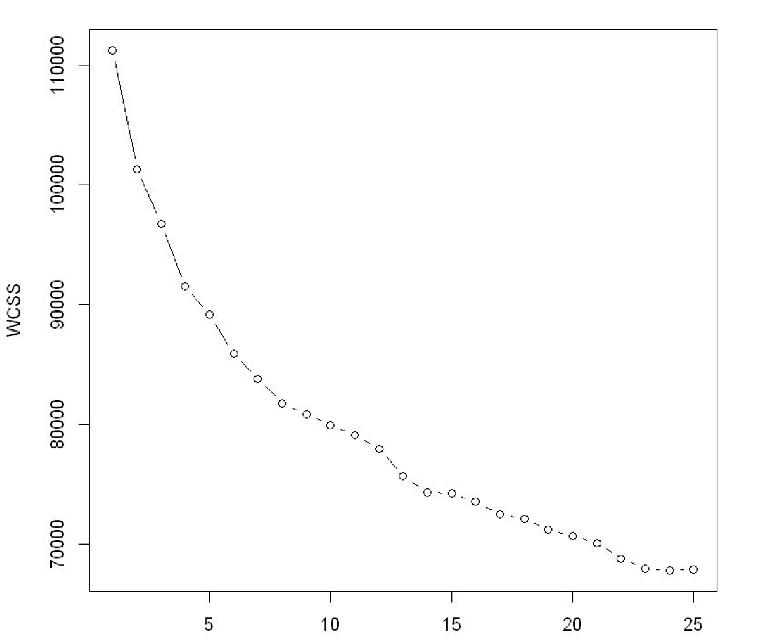
Elbow Method
It is used to choose optimal no of cluster.This method cannot give you the optimal number of clusters as an exact point, it can give you an optimal range .

Slide 20
Heat,low
Size , mb, speed,etc
.
Zoom, focus, lag,delay, etc.
,
good,lon g life,
Some Clusters :
Memory
Lens
Battery
better,ey e
,get,resol ution
size,weig ht,light,he avy,etc.
Well, time
,light,gre at
Brightness
Display
Design

Slide 21
Correspondence Analysis

Slide 22
Correspondence Analysis
Multivariate statistical technique
Geometric approach to categorical data analysis
Deals with categorical data
Perceptual maps are plotted for extracted components

Slide 23
Correspondence Analysis process
Measures of association,
Create perceptual map
Cat^{C}eªg^{te}o^{g}rºic^{ri}a^{ca}l ^{l}Variables
Contingency Table
Variables
Perceptual Maps

Slide 24
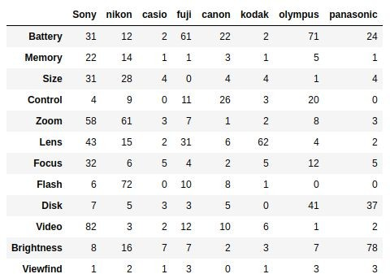
Contingency table
Tasks:
Relationship between Attributes
Relationship between Brands
Relationship between Attribute and Brands
Representing these relationships in a low dimensional space

Slide 25
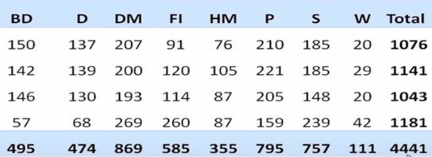
Table
A1
A2 A3 A4
Total

Slide 26
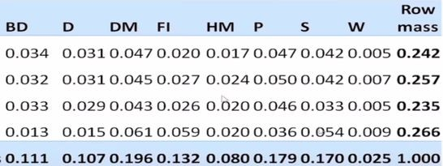
Correspondence Matrix
A1
A2 A3 A4
Col. Mass
z_{ij}= x_{ij}/N

Slide 27
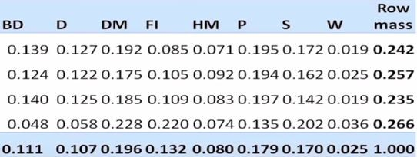
Row Proﬁles
A1
A2 A3 A4
Col. Mass
z_{ij}= z_{ij}/Rowmass[i]

Slide 28
Row Proﬁle
z_{ij}= x_{ij}/N
Z = Correspondence Matrix
z_{ij}= z_{ij}/Rowmass[i] ; where Rowmass[i]=Rowsum[i]/N N= Total sum
_{X} th
_{ij}= ij element in contingency table
Resulting matrix can be used to ﬁnd similarity/ dissimilarity between attriibutes

Slide 29
Correspondence Matrix
A1
A2 A3 A4
Col. Mass
z_{ij}= x_{ij}/N

Slide 30
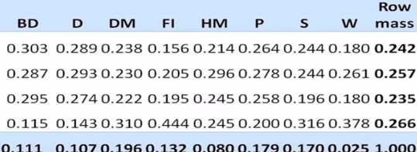
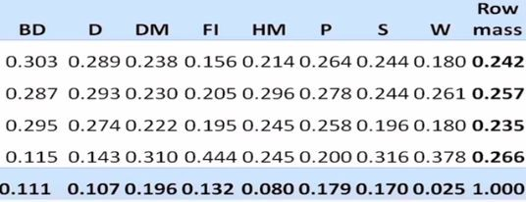
Column Proﬁles
A1
A2 A3 A4
Col. Mass
z_{ij}= z_{ij}/Column_mass[j]

Slide 31
Column Proﬁle
Relationship between Brands
Column Proﬁle
z_{ij}= x_{ij}/N
z_{ij}= z_{ij}/ColumnMass[j] ; where ColumnMass[j]=Columnsum[j]/N
N= Total sum _{x} th
_{ij}= ij element in contingency table
Resulting matrix can be used to ﬁnd similarity/ dissimilarity between Brands

Slide 32
Relationship between attribute and brand: Weighted 𝛘² Distance
-1 ½ T -1 ½
D = (D_{r} ) (Z - rc )(D_{c} )
Z = m x n Correspondence matrix r = m x1 Rowmass vector
c= n x 1 Columnmass vector D_{r} = m x m diag(r) matrix D_{c} = n x n diag(c) matrix

Slide 33
Interpretation
The vectors r and c give the marginal probabilities of being the row and column classes, respectively, while Z gives the joint probability distribution of rows and columns.
Z-rc^{T} gives deviation from independence.
D: chi-squared statistic, yielded from summing the deviations, squared and appropriately scaled.
If independent=> Z-rc = 0
If there is some non-zero distance=> attribute and brands are not independent

Slide 34
Reducing Dimensions : SVD
D = U𝚺V^{T} : Doing SVD of chi-sq distance matrix
Find U
Obtain row(Attribute) PCs: P = (D ⁻¹)^{½}UD
r
Obtain column(Brand) PCs : Q = (D ⁻¹)^{½}VD
c
 | PC1 | PC2..
A1
A2
..
B1
B2..

Slide 35
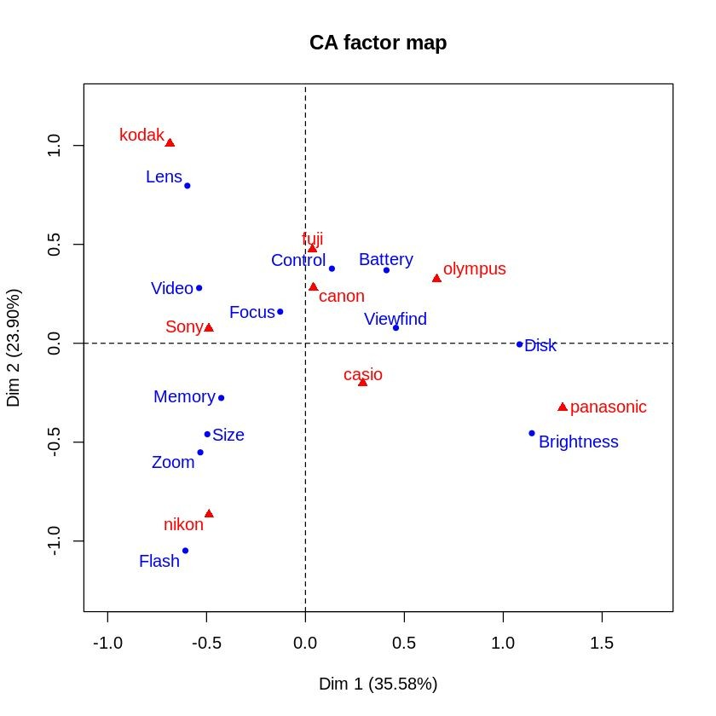
Perceptual Map
Implemented using FactoMineR and factoextra in R

Slide 36
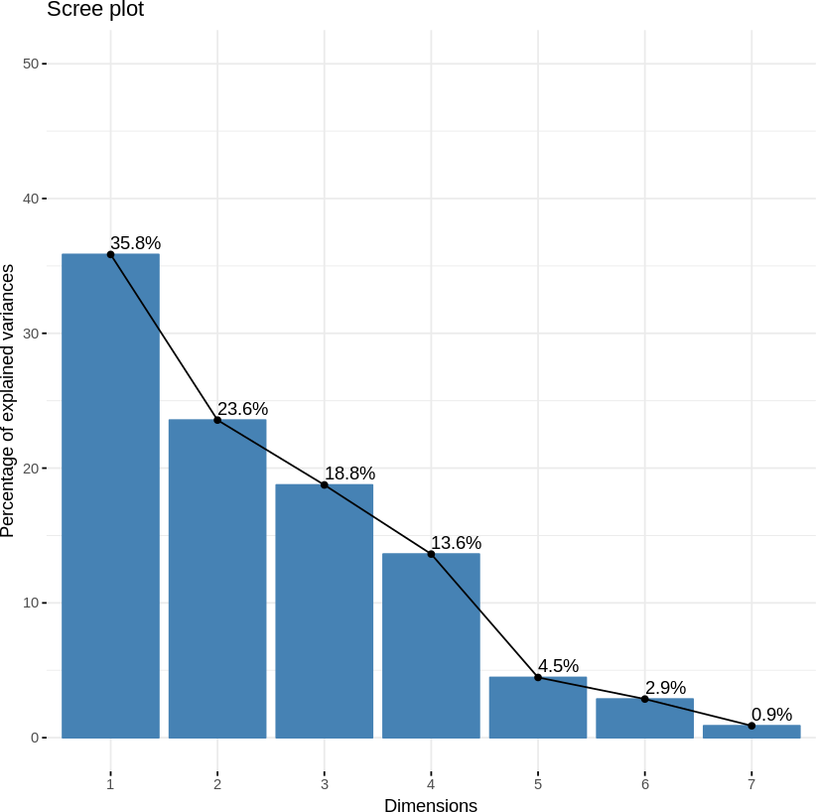
Scree plot

Slide 37
References
Automated Marketing Research Using Online Customer Reviews THOMAS Y.
LEE and ERIC T. BRADLOW
https://www.crummy.com/software/BeautifulSoup/bs4/doc/
https://en.wikipedia.org/wiki/Correspondence_analysis

